Slide 1
Help!
(Tools Metrics can make)
Kyle Lahnakoski
Engineering Productivity, Mozilla

Slide 2
ActiveData
ActiveData stores JSON documents
{
"run":{
"timestamp":1448535906
},
"result":{
"test":"test_getAll.js",
"duration":3.016
}
}
{
"run.timestamp":1448535906,
"result.test":"test_getAll.js",
"result.duration":3.016
}
{
run
timestamp
1448535906
result
result
test
test_getAll.js
duration
3.016
}
ElasticSearch does the heavy lifting as an in-memory columnar datastore

Slide 3
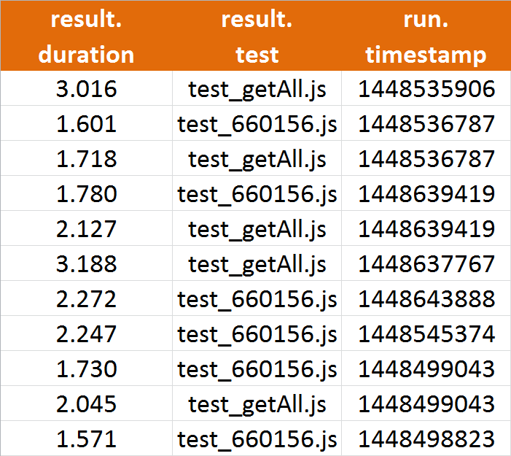
ActiveData
{
"run.timestamp":1448535906,
"result.test":"test_getAll.js",
"result.duration":3.016
}
run
timestamp
1448535906
result
test
test_getAll.js
result
duration
3.016
ActiveData queries documents as if they are records in a table

Slide 4
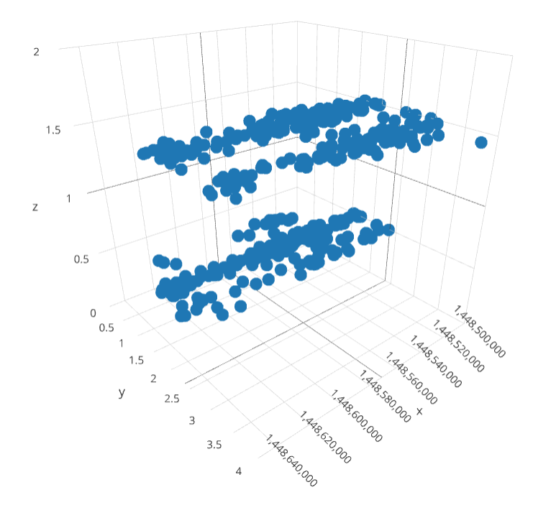

ActiveData
Even better, every column can be queried like an edge in a data cube; each row is a point in the cube

Slide 5
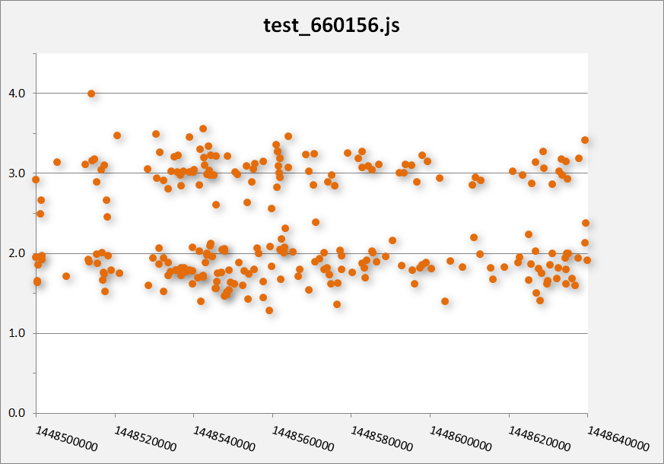
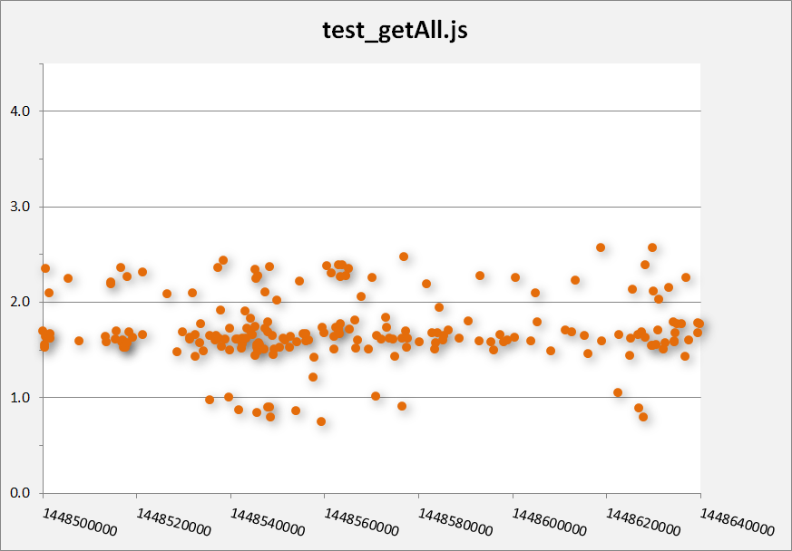
ActiveData
Slice the cube along the dimensions for humane presentation

Slide 6
ActiveData
Contents
Unit Test Results – 5 billion records:
75 dimensions, or more
Sub-minute response time
faster the second time (cached)
faster when scaled
Perf – 50 million
Buildbot job steps – 170 million

Slide 7
ActiveData
Built for analysis
Public service endpoint
Clean, Cartesian, data from JSON document store (read DataFrames).
Columns annotated with type, measurement units, domain cardinality, and domain members*
Distinction between dimensions and measures**
*still in prototype stage
**as defined by query

Slide 8
A Small Problem

Slide 9
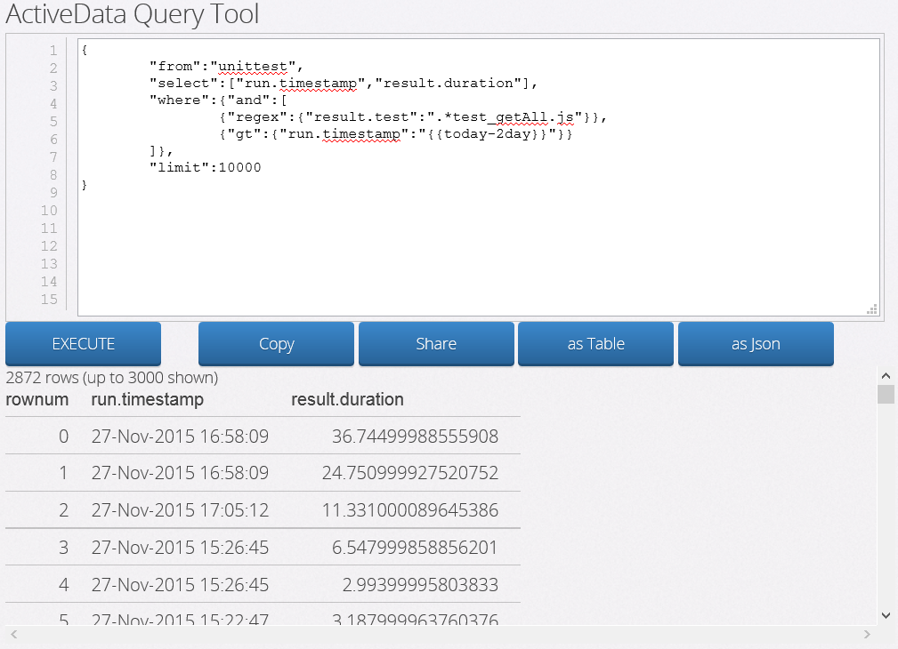

A Small Problem
Lists, tables and grids are hard to read
{
"from":"unittest",
"select":["run.timestamp","result.duration"],
"where":{"and":[
{"regex":{"result.test":".*test_getAll.js"}},
{"gt":{"run.timestamp":"{{today-2day}}"}}
]},
"limit":10000
}

Slide 10
Solution
Automated Charting

Slide 11
Automated Charting
Information required is Accessible
Access to columns’ domain: categorical or algebraic
Distinction between dimensions and measures
Enough information to decide how best to show a query result
Ranges that ignore those outliers

Slide 12
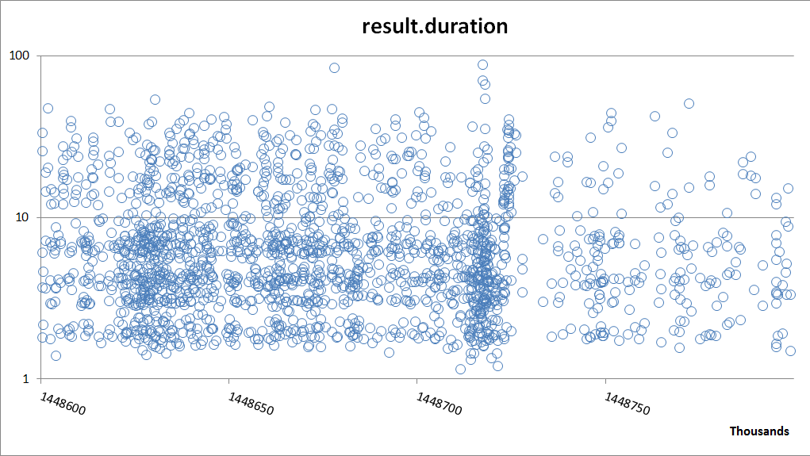

Automated Charting
Example

Slide 13
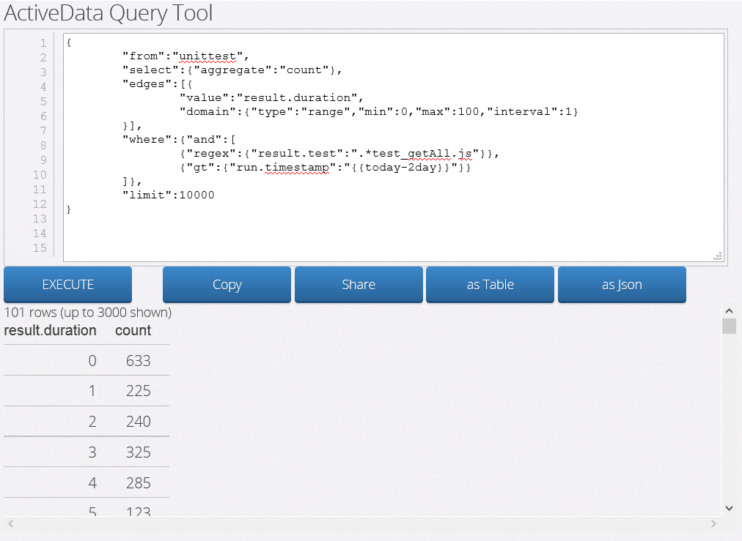
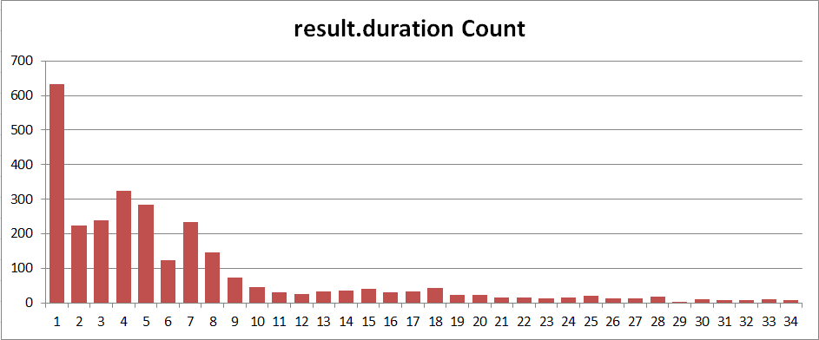
Automated Charting
Example
{
"from":"unittest",
"select":{"aggregate":"count"},
"edges":[{
"value":"result.duration",
"domain":{
"type":"range",
"min":0,
"max":100,
"interval":1
}
}],
"where":{"and":[
{"regex":{"result.test":".*test_getAll.js"}},
{"gt":{"run.timestamp":"{{today-2day}}"}}
]},
"limit":10000
}

Slide 14
The Big Problem

Slide 15
The Big Problem
Test results are consistent,
given time-of-day:
Possible slowdown caused by changeset
Retrigger multiple times, before and after, to confirm
All tests run at same time, giving consistent, but different, result.
Conclusion: Slowdown is real
Reality: Changeset code was never run!
Bug 1190877
Notes:
Wide sweeping generalization from just one bug?

Slide 16
The Big Problem
Test results are consistent,
given day-of-week:
Test infrastructure sees increase load on Monday
Performance tests slow down (???)
False positive alerts every Monday
Monday alerts are ignored
Blind to regressions introduced on Monday
Notes:
Wide sweeping generalization from just one bug?

Slide 17
The Big Problem
Good tests get disabled
t-Test is can detect change in modal behaviour, if lucky.
When unlucky, test is determined to “misbehave”, or have “excessive outliers”.
“Misbehaving” tests get ignored or disabled
Attachments show Bug 1196419 is detecting perf changes, yet there is suggestion to disable it.
Notes:
Wide sweeping generalization from just one bug? ..and was not disabled.

Slide 18
The Big Problem
Not enough engineers
Perf tests are generating 10’s of alerts per-day, many more if thresholds were not set so high.
Chasing a real regression requires backfill, and human time to track through the trees
False alerts are consuming valuable time
We are swamped …
We only just started …
Notes:
NOT SUGGESTING WE GET MORE RESOURCES, WE BE MORE INTELLEGENT ABOUT WHERE WE PUT OUR RESOURCES: WE CAN NOT DO THAT WITHOUT KNWOING THE IMPORTANT ASPECTS OF THE DATA WE HAVE

Slide 19
The Big Problem
Only just started?!
Perf has 450 tests (in 54 suites)
ActiveData has 30,000 (in 30 suites)
Not just test times (which are boring)
Test Failure Rates
Machine Failure rates
Platform/BuildOptions
Plus other dimensions from datasets we have not considered yet.

Slide 20
Non Solutions
Fixing the tests
Too many
Nothing to fix – multithreaded, jit optimizations, gc, are unavoidable
Not in scope (for Metrics)
Disabling tests
Manually ensure the t-test is applicable
Too many
Character changes too fast

Slide 21
The Solution
Automated Change Detection!

Slide 22
Automated Change Detection!
Math Strategies?
Mixture models for multimodal data?
2-state Markov model for weekends?
Periodic model?
Include estimates of models’ accuracy
When not enough data, more can be requested

Slide 23
Automated Change Detection!
Implementation?
Unreasonably effective t-test – we are missing way to confirm the data matches its assumptions.
Iterative Solution! – add one model at a time; ensuring we have a way to pick the best.
Machine Learning? – too computationally intensive, given we already know how to solve.
Notes:
Must distinguish between t-test working, and just lucky

Slide 24
Automated Change Detection!
Engineering?
ActiveData manages ETL issues
ActiveData can provide the data frames to analysis tools.
MozCI to (re)trigger tests.
Must handle backfilling data and the different conclusions that result (lifecycle).
Feed conclusions to apps that UI humans (PerfHerder, AlertManager, dzAlerts)
Notes:
Must distinguish between t-test working, and just lucky

Slide 25
The Future!
With Automated Change Detection
Track regressions and improvements down to the changeset and bug.
…or no evidence, or not enough machine resources to make a conclusion
Each Firefox release can list the bugs and sum regressions/improvements
Sheriffs are not needed to manage regressions
Find anomalies in slices we never considered!

Slide 26
End

